Slide 1
IoT's Role in Energy Efficiency

Slide 2
IoT's Role in Energy Efficiency
Using IoT for Energy Efficient Buildings and Cities
Contents
Introduction
IoT Concepts and Applications
Energy Efficiency in Smart Buildings
Challenges with IoT Implementation
IoT in Smart Cities
Future Potential of IoT
Case Studies
Regulatory Frameworks

Slide 3
IoT's Role in Energy Efficiency
Public Awareness and Education
Conclusion

Slide 4
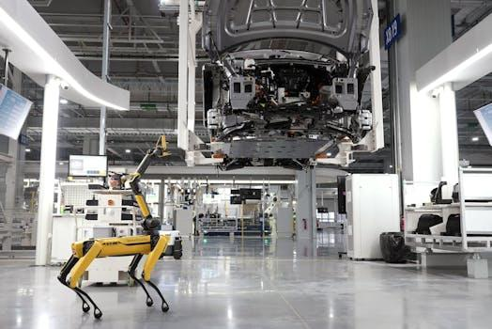
Contents
Introduction Overview: This section introduces IoT's pivotal role in enhancing energy efficiency within urban environments.
Smart Buildings Focus: Explores IoT applications specifically aimed at improving energy management and resource optimization in buildings.
Challenges Logistics: Addresses the key difficulties and barriers encountered during IoT systems implementation in building infrastructures.
Photo by Hyundai Motor Group on Pexels

Slide 5

Introduction
Energy Consumption Reduction: IoT applications efficiently monitor and manage energy usage, significantly minimizing waste in smart infrastructures.
Addressing Knowledge Gaps: Highlighting existing knowledge gaps enhances understanding of IoT’s potential, crucial for implementing energy-efficient solutions.
Impact on Sustainable Practices: Educating stakeholders on IoT benefits fosters commitment to sustainability, promoting broader acceptance of efficient technologies.
Photo by Pixabay on Pexels

Slide 6

IoT Concepts and Applications
RFID Introduction: Kevin Ashton's 1999 introduction of RFID marked a pivotal moment for IoT technology's inception and evolution.
Seamless Integration Potential: IoT holds immense potential for seamless integration into existing infrastructure, enhancing operational efficiency and performance.
Connected Devices Growth: Currently exceeding 31 billion connected devices, projections estimate a staggering increase to 170 billion by 2050.
Photo by Susanne Plank on Pexels

Slide 7
Energy Efficiency in Smart Buildings
Role of IoT Sensors: IoT sensors continuously monitor energy consumption, providing real-time data to streamline efficiency across systems.
Predictive Analytics Utilization: Advanced predictive analytics utilize data gathered from sensors to optimize energy usage and reduce costs.
User Behavior Profiling: Analyzing user behavior enables customized energy strategies, enhancing the overall effectiveness of consumption patterns.

Slide 8
Challenges with IoT Implementation
Technical Limitations: Complexities in integrating IoT systems hinder widespread adoption, impacting scalability and interoperability across diverse devices.
Security Concerns: Data management and privacy issues arise from IoT deployments, necessitating robust security measures to protect users.
E-Waste Implications: The proliferation of IoT devices raises e-waste concerns, emphasizing the need for sustainable recycling solutions and practices.

Slide 9

IoT in Smart Cities
Smart Grids Integration: Two-way electricity flows in smart grids enhance efficiency by allowing real-time demand and supply adjustments.
Home Energy Management: These systems optimize energy use within homes, leveraging IoT data for enhanced efficiency and cost savings.
Intelligent Street Lighting: Automatic street lighting adapts to environmental conditions, conserving energy based on actual activity or daylight levels.
Photo by Anete Lusina on Pexels

Slide 10

Future Potential of IoT
Emerging Technologies: Innovations like machine learning and edge computing will enhance real-time energy management in urban settings.
Data-Driven Insights: Advanced analytics from IoT devices can inform policy decisions, driving targeted sustainability initiatives in cities.
Collaborative Networks: Ecosystems promoting partnerships between stakeholders enable comprehensive approaches to achieving shared energy efficiency goals.
Photo by Jakub Zerdzicki on Pexels

Slide 11
Case Studies
Case Study: Barcelona: Barcelona implemented IoT-enabled traffic management systems, optimizing energy use and reducing congestion through real-time data.
Case Study: Singapore: Singapore's Smart Nation initiative integrates IoT for sustainable urban living, enhancing energy efficiency in buildings and transport.
Case Study: Stockholm: Stockholm utilizes IoT for smart waste management, improving resource efficiency while minimizing environmental impact in urban settings.

Slide 12
Regulatory Frameworks
Regulatory Frameworks: Existing regulations support IoT deployment, ensuring compliance and promoting energy efficiency through structured guidelines.
Standardization Importance: Establishing universal standards enhances interoperability among IoT devices, crucial for effective energy management solutions.
Policy Recommendations: Policies encouraging investment in IoT for energy efficiency can catalyze widespread adoption and technological advancements.

Slide 13

Public Awareness and Education
Public Engagement Necessity: Engaging the public enhances awareness of IoT technologies, thus fostering community-driven energy efficiency initiatives.
Educational Programs Development: Implementing educational programs focused on IoT benefits cultivates informed citizens committed to sustainable practices.
Stakeholder Collaboration Importance: Collaborative efforts among stakeholders amplify outreach, ensuring diverse participation in IoT-driven energy solutions.
Photo by John Tekeridis on Pexels

Slide 14

Conclusion
Transformative Energy Management: IoT systems revolutionize energy management, enabling predictive maintenance and real-time optimization for sustainability.
Scalability in Implementation: The scalable nature of IoT solutions supports widespread adoption, enhancing energy efficiency across multiple buildings and cities.
Long-term Sustainability Goals: Integrating IoT fosters alignment with global sustainability goals, driving systemic changes that promote resource conservation.
Photo by Alena Koval on Pexels

